Slide 1
Texture Mapping
Presented By:
Dr. Sk. Md. Masudul Ahsan
Professor
CSE, KUET
Md Nazirul Hasan Shawon
Lecturer
CSE, KUET

Slide 2
Outlines
What is Texture Mapping
Why Texture Mapping
Linear Texture Mapping
Mipmapping
Texture Related OpenGL Functions
Texture Wrapping
Texture Filtering

Slide 3
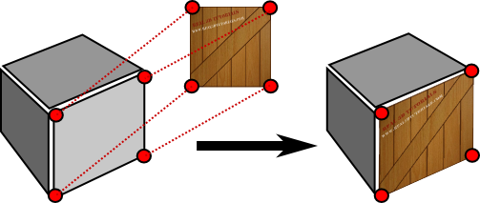
What is Texture Mapping
A graphic design process in which a two-dimensional (2-D) surface, called a texture map, is "wrapped around" a three-dimensional (3-D)object.
3-D object acquires a surface texture similar to that of the 2-D surface.
Texture mapping is the electronic equivalent of applying wallpaper, paint, or veneer to a real object.

Slide 4
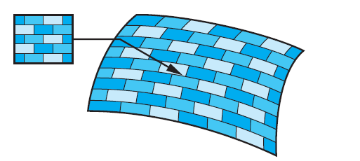
Texture Mapping
Texture mapping uses an image (or texture) to influence the color of a fragment. Textures can be specified using a fixed pattern, such as the regular patterns often used to fill polygons; by a procedural texture-generation method; or through a digitized image.

Slide 5
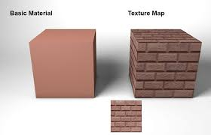
Why Texture Mapping
Adds realism to the scene
Draw a large brick wall without texturing, each brick must be drawn as a separate polygon
But With texturing a large flat wall is just a single polygon

Slide 6
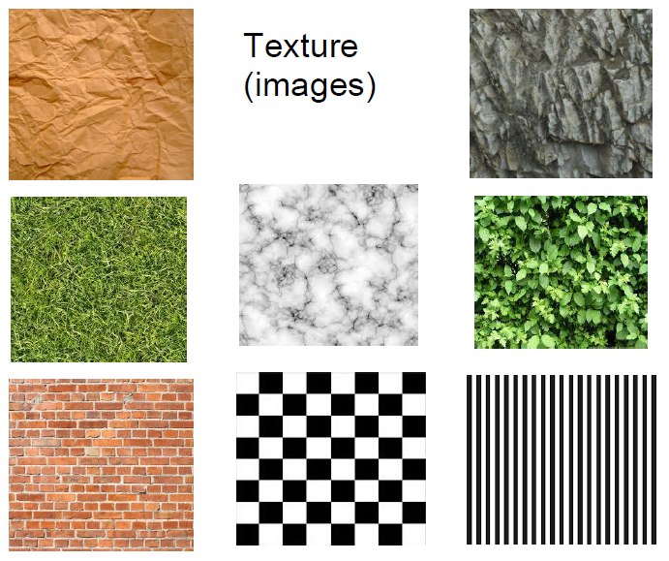
Example of Texture

Slide 7
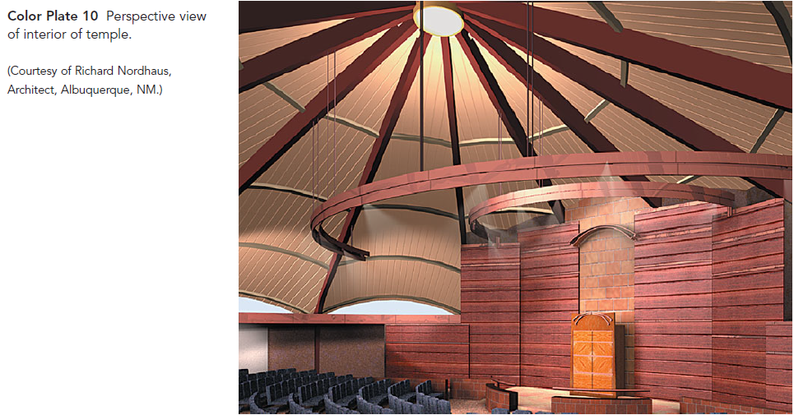
Example of Texture Mapping

Slide 8
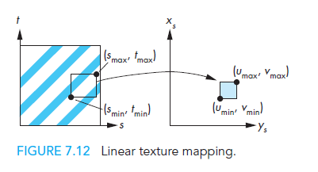
Linear Texture Mapping
Do a direct mapping of a block of texture to a surface patch:

Slide 9
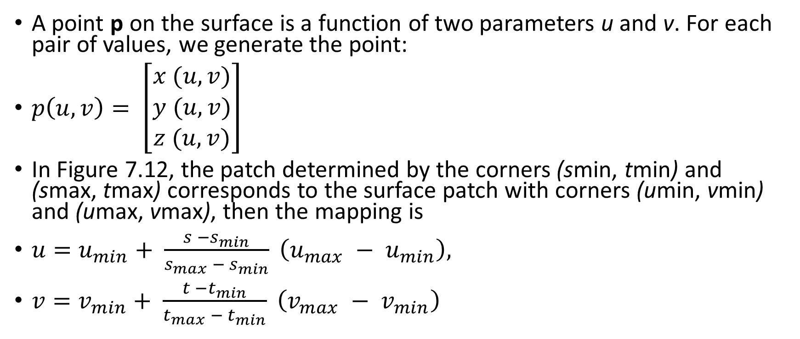
Linear Texture Mapping
A point p on the surface is a function of two parameters u and v. For each pair of values, we generate the point:
$p\left(u,v\right)= \left[\begin{matrix}x (u,v) \\ y (u,v) \\ z (u,v)\end{matrix}\right]$
In Figure 7.12, the patch determined by the corners (smin, tmin) and (smax, tmax) corresponds to the surface patch with corners (umin, vmin) and (umax, vmax), then the mapping is
${u=u}_{min}+ \frac{s −s_{min}}{s_{max} − s_{min}} \left(u_{max} − u_{min}\right),$
${v=v}_{min}+ \frac{t −t_{min}}{t_{max} − t_{min}} \left(v_{max} − v_{min}\right)$

Slide 10
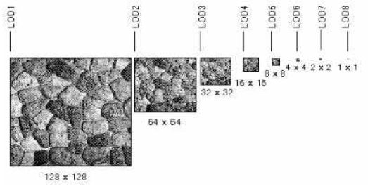
Mipmapping
Pre-calculate how the texture should look at various distances, then use the appropriate texture at each distance. This is called mipmapping.

Slide 11
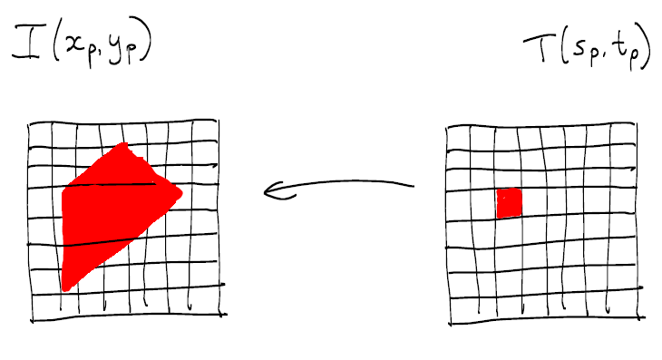
Texture magnification
a pixel in texture image ('texel') maps to an area larger than one pixel in image

Slide 12
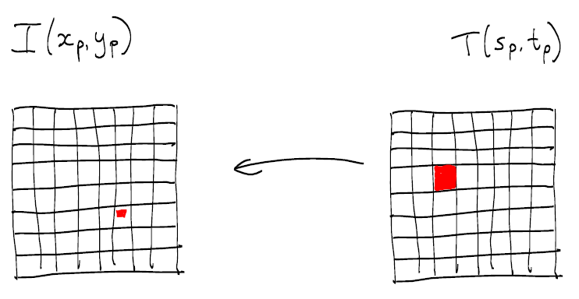
Texture minification
a pixel in texture image('texel') maps to an area smaller than a pixel in image:

Slide 13
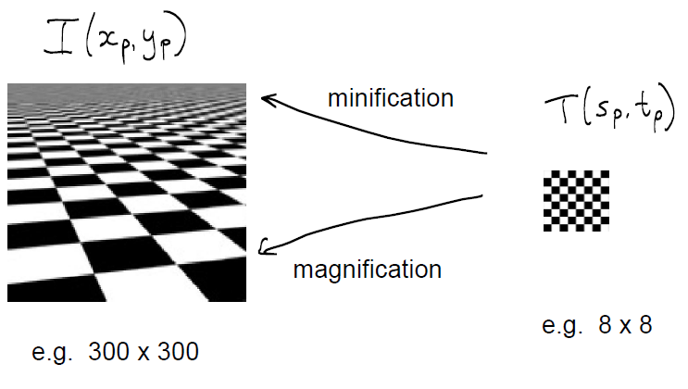
Mipmapping

Slide 14
Texture Related OpenGL Functions: glBindTexture()
glBindTexture(GL_TEXTURE_2D,textureName);
GL_TEXTURE_2D: Specify that it is a 2D texture
textureName: Name of the texture

Slide 15
Texture Related OpenGL Functions: glTexImage2D()
glTexImage2D(GL_TEXTURE_2D, level, components, width, height, border, format, type, tarray)
GL_TEXTURE_2D: Specify that it is a 2D texture
Level: Used for specifying levels of detail for mipmapping
Components: Generally is 0 which means GL_RGB, Represents components and resolution of components
Width, Height: The size of the texture must be powers of 2
Border Format: Specify what the data is (GL_RGB, GL_RGBA, …)
Type: Specify data type (GL_UNSIGNED_BYTE, GL_BYTE, …)

Slide 16
Texture Related OpenGL Functions: glTexParameteri()
glTexParameteri(GL_TEXTURE_2D, GL_TEXTURE_MAG_FILTER, GL_LINEAR);
This function sets several texture mapping parameters. These parameters are bound to the current texture state that can be made current with glBindTexture.
parameters:
P1: GLenum: The texture target for which this parameter applies. Must be one of GL_TEXTURE_1D, GL_TEXTURE_2D, GL_TEXTURE_3D, or GL_TEXTURE_CUBE_MAP.
P2: GLenum: The texturing parameter to set. GL_TEXTURE_MAG_FILTER Returns the texture magnification filter value
P3: GLfloat or GLfloat* or GLint or GLint*: Value of the parameter specified by pname.

Slide 17
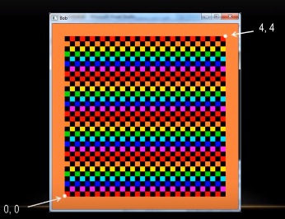
Texture Wrapping: GL_REPEAT

Slide 18
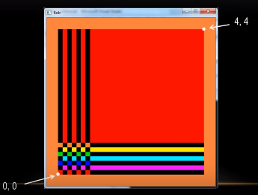
Texture Wrapping: GL_CLAMP

Slide 19
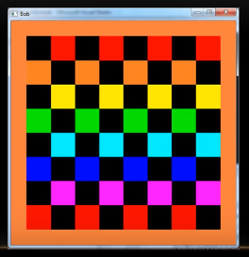
Texture Filtering: GL_NEAREST

Slide 20
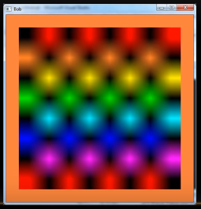
Texture Filtering: GL_LINEAR

Slide 21
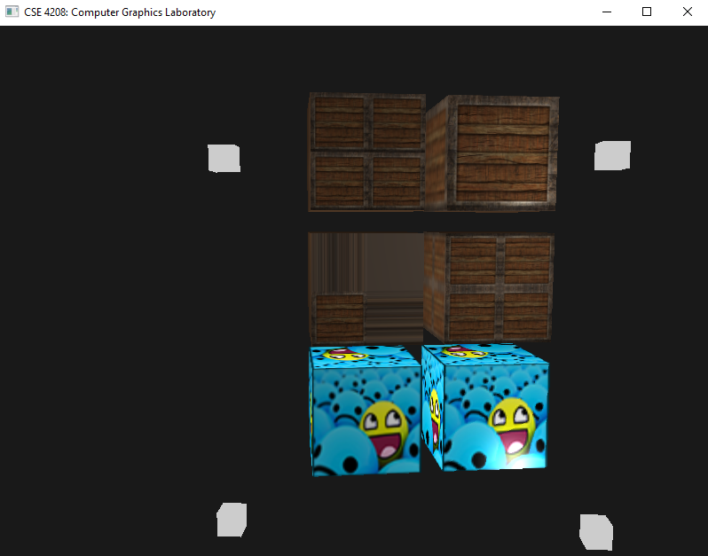
GL_REPEAT, GL_CLAMP_TO_EDGE, GL_MIRRORED_REPEAT, GL_LINEAR, GL_NEAREST

Slide 22
References
Anonymously Collected

